Slide 1
SIMD Processors (Vector Processing)
P. K. Roy
Asst. Professor
Siliguri Institute of Technology

Slide 2
Problems with conventional approach
Limits to conventional exploitation of ILP: 1) pipelined clock rate: at some point, each increase in clock rate has corresponding CPI increase (branches, other hazards)
2) instruction fetch and decode: at some point, its hard to fetch and decode more instructions per clock cycle
3) cache hit rate: some long-running (scientific) programs have very large data sets accessed with poor locality; others have continuous data streams (multimedia) and hence poor locality

Slide 3
Supercomputers
Fastest machine in world at given task
A device to turn a compute-bound problem into an I/O bound problem
Any machine costing $30M+
Any machine designed by Seymour Cray
CDC6600 (Cray, 1964) regarded as first supercomputer

Slide 4
Supercomputer Applications
Typical application areas
Military research (nuclear weapons, cryptography)
Scientific research
Weather forecasting
Oil exploration
Industrial design (car crash simulation)
All involve huge computations on large data sets
In 70s-80s, Supercomputer ≡ Vector Machine

Slide 5
Why Vector Processors?
A single vector instruction specifies a great deal of work—it is equivalent to executing an entire loop.
The computation of each result in the vector is independent of the computation of other results in the same vector and so hardware does not have to check for data hazards within a vector instruction.
Hardware need only check for data hazards between two vector instructions once per vector operand, not once for every element within the vectors.
Vector instructions that access memory have a known access pattern.
Because an entire loop is replaced by a vector instruction whose behavior is predetermined, control hazards that would normally arise from the loop branch are nonexistent.

Slide 6
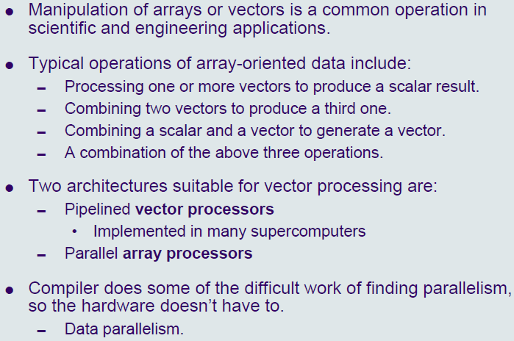
Vector Processing

Slide 7
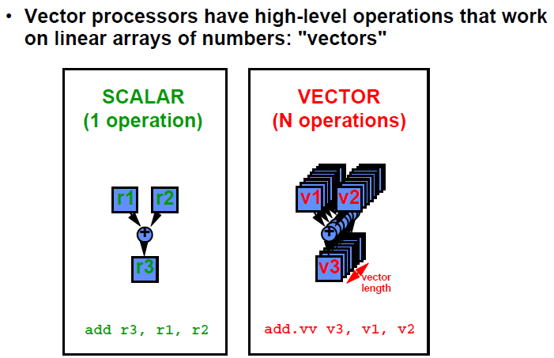
Vector Processor(1)

Slide 8
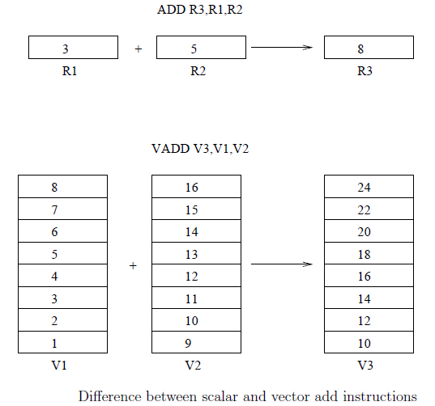
Vector Processor(2)

Slide 9
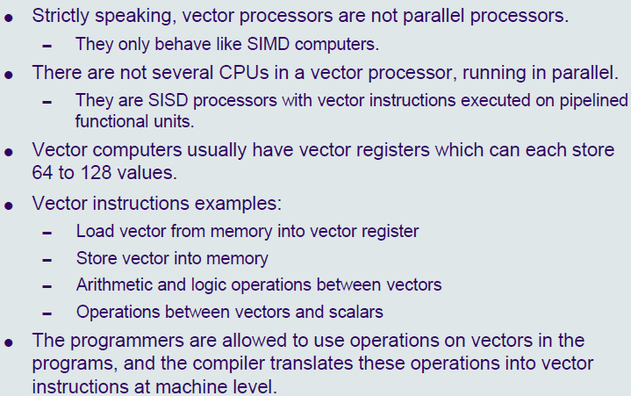
Vector Processor(3)
Self-Review : Vector instructions from Kai Hwang

Slide 10
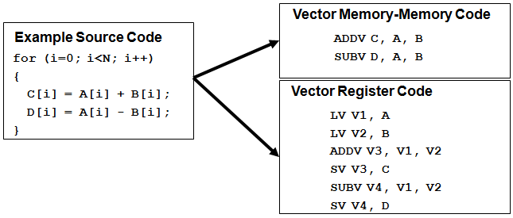
Vector Processor(4)

Slide 11
Vector Architecture(1)
Basic idea:
Read sets of data elements into “vector registers”
Operate on those registers
Disperse the results back into memory
Registers are controlled by compiler
Register files act as compiler controlled buffers
Used to hide memory latency
Leverage memory bandwidth
Vector loads/stores deeply pipelined
pay for memory latency once per vector ld/st!
Regular loads/stores
pay for memory latency for each vector element

Slide 12
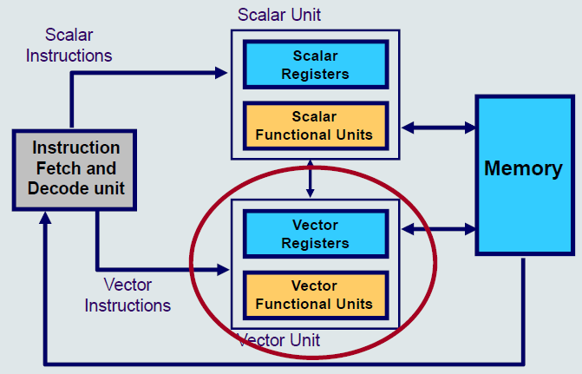
Vector Architecture(2)

Slide 13
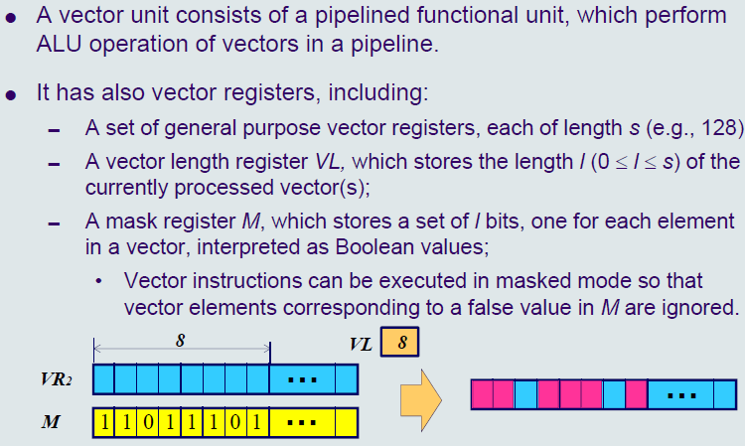
Vector Unit

Slide 14
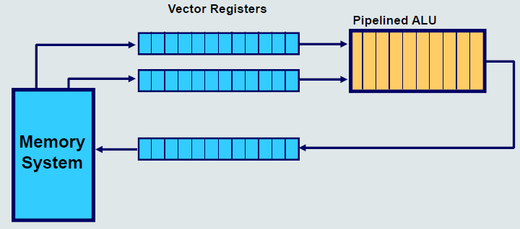
Vector Unit Operation Model

Slide 15
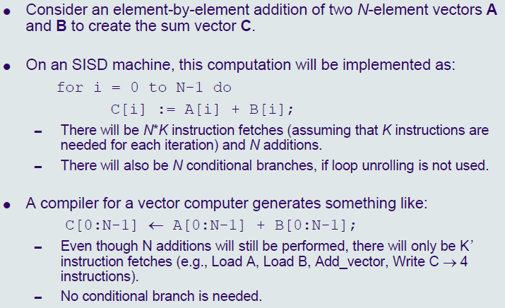
Vector Program

Slide 16
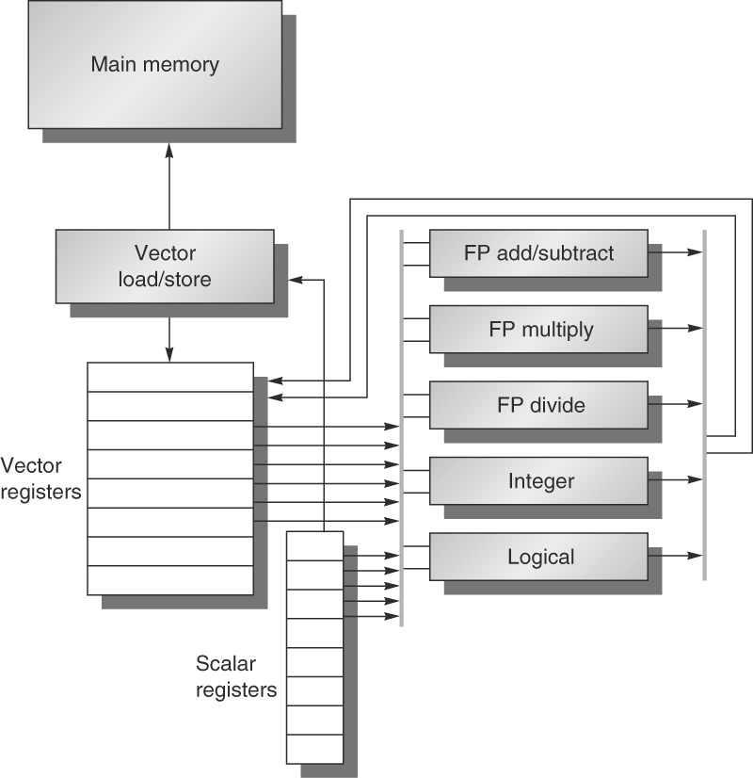
Example: VMIPS
Vector registers
Each register holds a 64-element, 64 bits/element vector
Register file has 16 read ports and 8 write ports
Vector functional units
Fully pipelined
Data and control hazards are detected
Vector load-store unit
Fully pipelined
Words move between registers
One word per clock cycle after initial latency
Scalar registers
32 general-purpose registers
32 floating-point registers

Slide 17
Vector Chaining(1)
Vector version of register bypassing
Chaining
Allows a vector operation to start as soon as the individual elements of its vector source operand become available
Results from the first functional unit are forwarded to the second unit

Slide 18
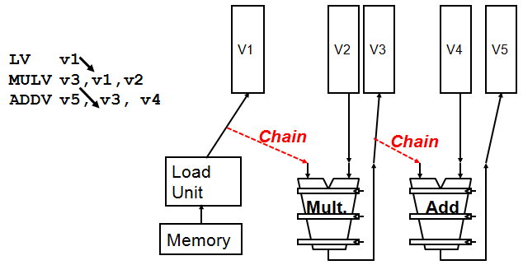
Vector Chaining(2)

Slide 19
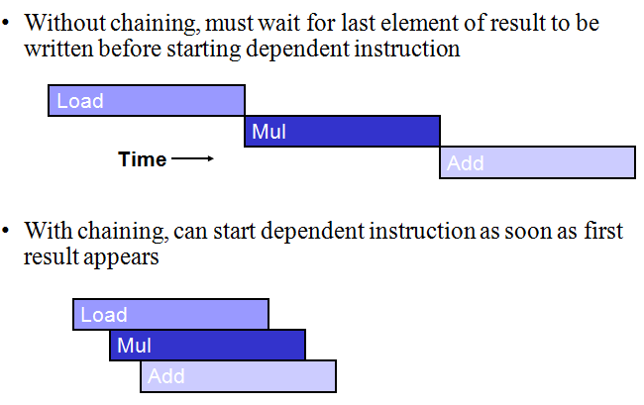
Vector Chaining(3)

Slide 20
Advantages of Vector Processing
Each result is independent of previous results - allowing deep pipelines and high clock rates.
A single vector instruction performs a great deal of work - meaning less fetches and ewer branches (and in turn fewer mispredictions).
Vector instructions access memory a block at a time which allows memory latency to be amortized over many elements.
Vector instructions access memory with known patterns, which allows multiple memory banks to simultaneously supply operands.
Less memory access = faster processing time.

Slide 21
Disvantages of Vector Processing
Not as fast with scalar instructions
Complexity of the multi-ported VRF
Difficulties implementing precise exceptions
High price of on-chip vector memory systems
Increased code complexity

Slide 22
Array Processors

Slide 23
Array processor(1)
A vector (one dimensional array)
A set of vectors (multi-dimensional array)
Array processor ─ a processor capable of processing array elements
Suitable for scientific computations involving two dimensional matrices
Array processor performs a single instruction in multiple execution units in the same clock cycle
The different execution units have same instruction using same set of vectors in the array

Slide 24
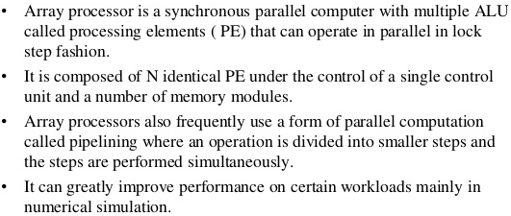

Array processor(2)

Slide 25
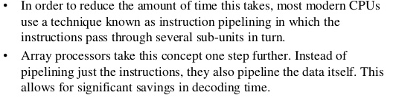
Array processor(3)

Slide 26
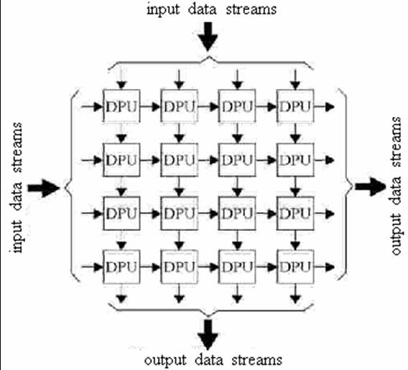
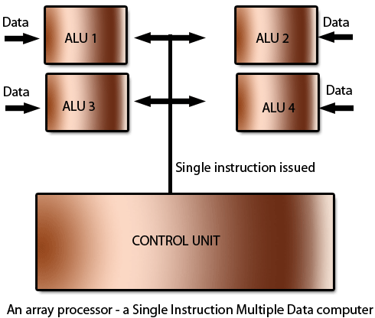
Array processor(4)

Slide 27
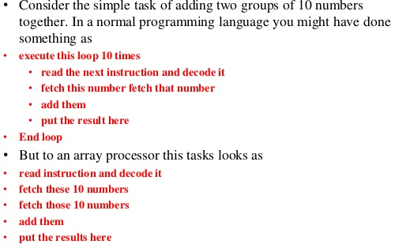
How Array Processor Can Help?

Slide 28
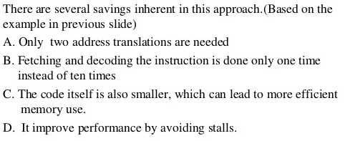
How Array Processor Can Help?

Slide 29
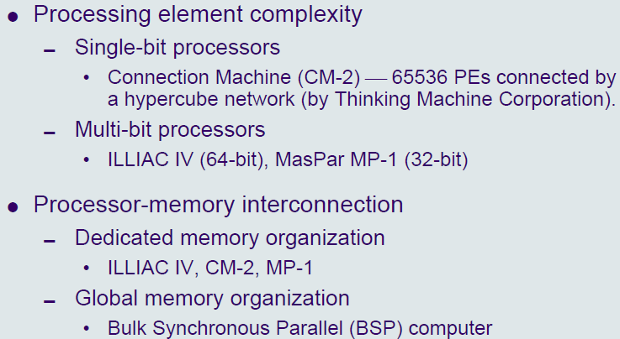
Classification

Slide 30
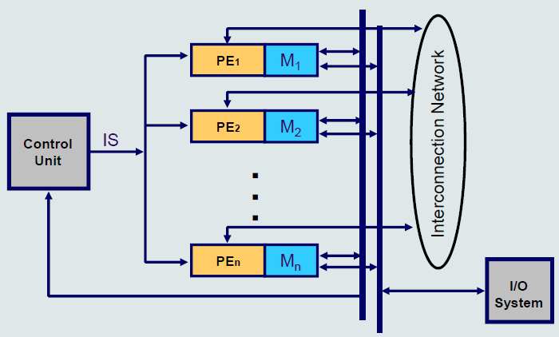
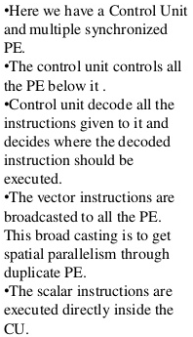
Dedicated Memory Organization

Slide 31
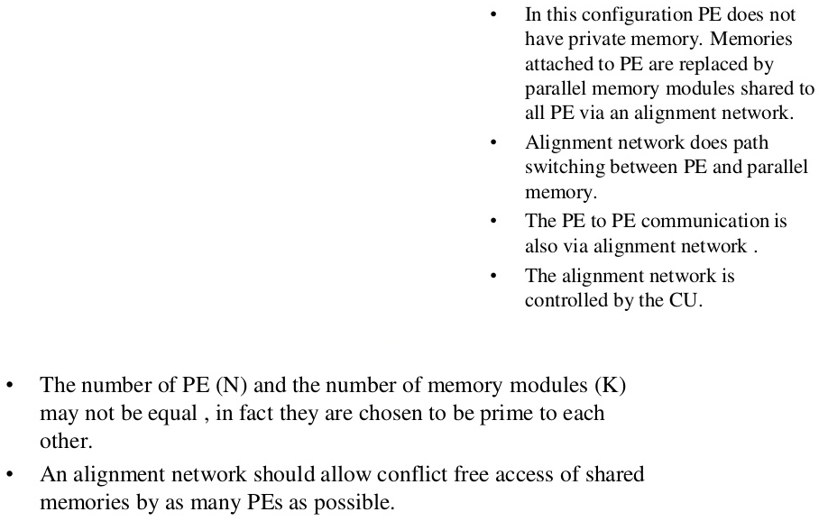
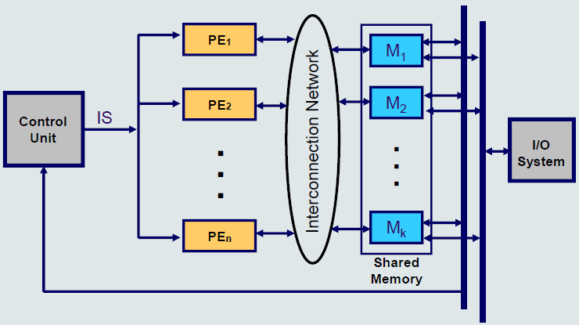
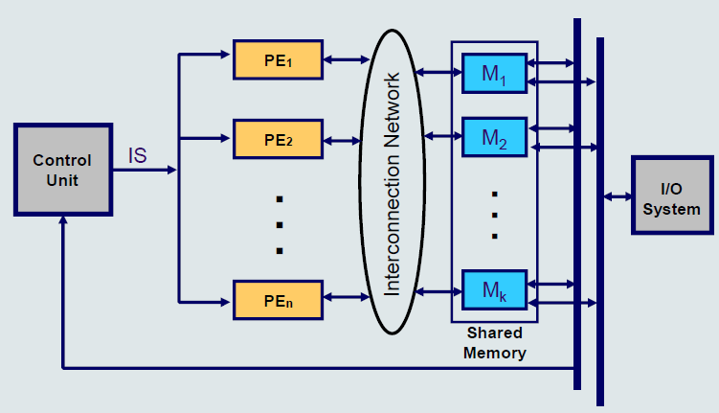
Global Memory Organization(1)

Slide 32
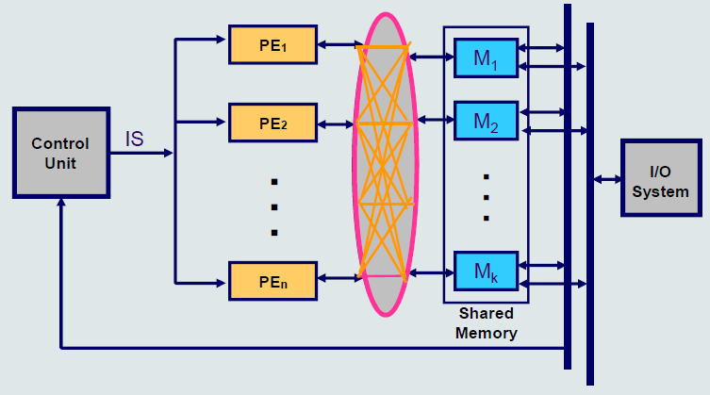
Global Memory Organization(2)
Alignment/Interconnection

Slide 33
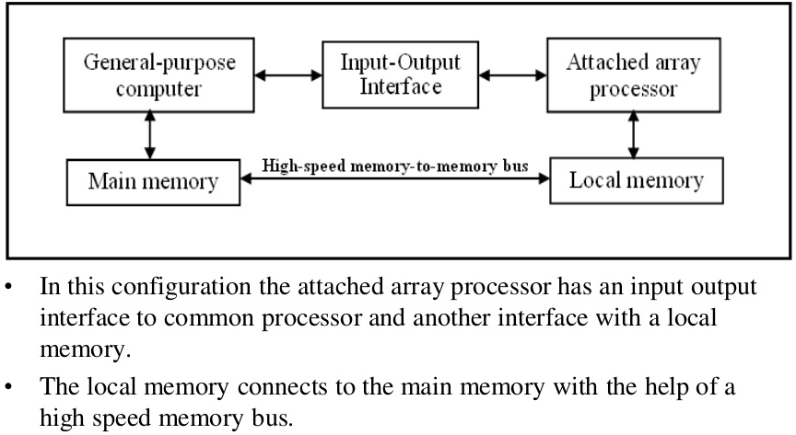
Attached Array Processor

Slide 34
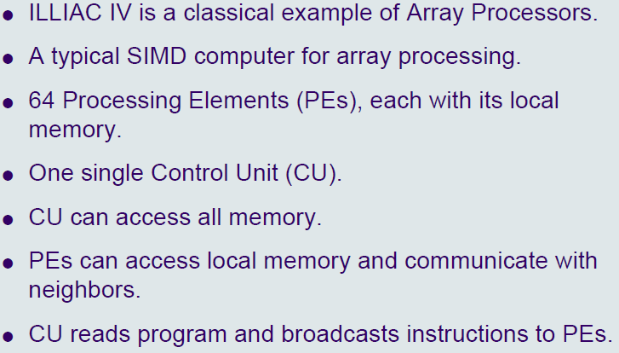
ILLIAC IV

Slide 35
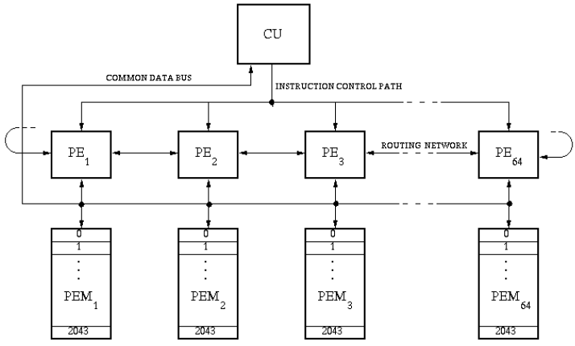
ILLIAC IV Architecture

Slide 36

References
PPT on Pipelining from CS303 (3rd Semester)
Advanced Computer Architecture – Kai Hwang
Advanced Computer Architectures – Dezso Sima, Peter Karsuk
Computer Organization – Carl Hamacher
Computer Architecture & Organization – John P. Hayes
Computer System Architecture – M. Morris Mano
Computer Organization & Architecture – T. K. Ghosh
Computer Organization & Architecture – Xpress Learning

